Slide 1
Parallel Computing
Threads and OpenMP

Slide 2
Outline
Shared Memory Hardware
Parallel Programming with Threads
Parallel Programming with OpenMP
See http://www.nersc.gov/nusers/help/tutorials/openmp/
Summary

Slide 3
Shared Memory Hardware

Slide 4
Shared vs. Distributed Memory
CPU 0
CPU 1
CPU 2
CPU 3
CPU 0
CPU 1
CPU 2
CPU 3
MEM 0
MEM 1
MEM 2
MEM 3
MEM
distributed
shared
distributed memory refers to a multiprocessor computer system in which each processor has its own private memory. Computational tasks can only operate on local data, and if remote data is required, the computational task must communicate with one or more remote processors.
a shared memory multiprocessor offers a single memory space used by all processors. Processors do not have to be aware where data resides, except that there may be performance penalties, and that race conditions are to be avoided.

Slide 5
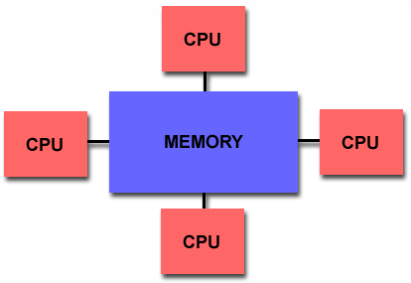
Recall Shared memory architectures
Multiple CPU’s (or cores)
One memory with a global address space
May have many modules
All CPUs access all memory through the global address space
All CPUs can make changes to the shared memory
Changes made by one processor are visible to all other processors?
Data parallelism or function parallelism?

Slide 6
Shared memory Computers
Shared memory computer : any computer composed of multiple processing elements that share an address space. Two Classes:
Symmetric multiprocessor (SMP): a shared address space with “equal-time” access for each processor, and the OS treats every processor the same way.
Non Uniform address space multiprocessor (NUMA): different memory regions have different access costs … think of memory segmented into “Near” and “Far” memory.
Proc₁
Proc₂ Proc₃
Shared Address Space
Proc_{N}
31/36

Slide 7
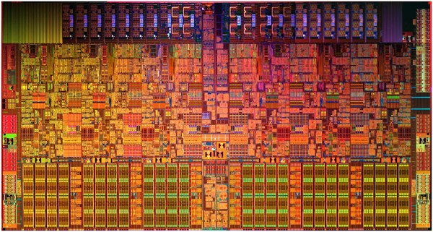
Shared memory machines: SMP
Intel® Core™ i7-970 processor: Often called an SMP, but is it?
Memory Controller
L2
L2
L2
L2
L2
L2
L3
6 cores, 2-way multithreaded, 6-wide superscalar, quad-issue, 4-wide SIMD (on 3 of 6 pipelines)
4.5 KB (6 x 768 B) “Architectural” Registers, 192 KB (6 x 32 KB) L1
Cache, 1.5 MB (6 x 256 KB) L2 cache, 12 MB L3 Cache
MESIF Cache Coherence, Processor Consistency Model
1.17 Billion Transistors on 32 nm process @ 2.6 GHz
33/3
Cache hierarchy means different processors have different
costs to access different address ranges …. It’s NUMA
6

Slide 8
Parallel Programming with Threads

Slide 9
Shared Memory Programming
Several Thread Libraries/systems
PTHREADS is the POSIX Standard
Relatively low level
Portable but possibly slow; relatively heavyweight
OpenMP standard for application level programming
Support for scientific programming on shared memory
http://www.openMP.org
TBB: Thread Building Blocks
Intel
CILK: Language of the C “ilk”
Lightweight threads embedded into C
Java threads
Built on top of POSIX threads
Object within Java language
Notes:
POSIX = Portable Operating System Interface
Slow if needs to go to OS for every thread operation
Java threads built on POSIX threads:
Are objects (like other objects in Java)
(1) create Java thread object
(2) send it a message saying “run” etc

Slide 10

The Parallel programming process:
Find Concurrency (
Original Problem
Tasks, shared and local
data
Program SPMD_Emb_Par () Program SPMD_Emb_Par ()
Program SPMD_Emb_Par () Program SPMD_Emb_Par ()
{
TYPE *tmp, *func();
{
TYPE *tmp, *func(); global_array Data(TYPE); global_array Res(TYPE); int N = get_num_procs(); int id = get_proc_id();
if (id==0) setup_problem(N,DATA); for (int I= 0; I<N;I=I+Num){
tmp = func(I); Res.accumulate( tmp);
}
}
{
TYPE *tmp, *func(); global_array Data(TYPE); global_array Res(TYPE); int N = get_num_procs(); int id = get_proc_id();
if (id==0) setup_problem(N,DATA); for (int I= 0; I<N;I=I+Num){
tmp = func(I); Res.accumulate( tmp);
}
}
{
TYPE *tmp, *func(); global_array Data(TYPE);
global_array Res(TYPE); int N = get_num_procs(); int id = get_proc_id();
if (id==0) setup_problem(N,DATA); for (int I= 0; I<N;I=I+Num){
tmp = func(I); Res.accumulate( tmp);
}
}
Implementation strategy
global_array Data(TYPE);
global_array Res(TYPE);
int Num = get_num_procs();
int id = get_proc_id();
if (id==0) setup_problem(N, Data);
for (int I= ID; I<N;I=I+Num){ tmp = func(I, Data); Res.accumulate( tmp);
}
Units of execution + new shared data for extracted dependencies
}
Corresponding source
code

Slide 11
Thread
A process is an instance of a computer program that is being executed. It contains the program code and its current activity.
A thread of execution is the smallest unit of processing that can be scheduled by an operating system.
Differences between threads and processes:
A thread is contained inside a process. Multiple threads can exist within the same process and share resources such as memory.
The threads of a process share the latter’s instructions (code) and its context (values that its variables reference at any given moment). – Different processes do not share these resources.
http://en.wikipedia.org/wiki/Process_(computing)

Slide 12
Process
A process contains all the information needed to execute the program
Process ID
Program code
Data on run time stack
Global data
Data on heap
Each process has its own address space

Slide 13
Threads
Thread model is an extension of the process model.
Each process consists of multiple independent instruction streams (or threads) that are assigned computer resources by some scheduling procedure.
Threads of a process share the address space of this process.
Global variables and all dynamically allocated data objects are accessible by all threads of a process
Each thread has its own run time stack, register, program counter.
Threads can communicate by reading/writing variables in the common address space.

Slide 14
Programming Model : Shared Memory
Program is a collection of threads of control.
Can be created dynamically, mid-execution, in some languages
Each thread has a set of private variables, e.g., local stack variables
Also a set of shared variables, e.g., static variables, shared common blocks, or global heap.
Threads communicate implicitly by writing and reading shared variables.
Threads coordinate by synchronizing on shared variables
Shared memory
s
s = ...
y = ..s ...
i: 2
i: 5
Private memory
i: 8
P0
P1
Pn
Notes:
Example: think of a thread as a subroutine that gets called on on processor, executed on another
Like concurrent programming on a uniprocessor (as studied in CS162).

Slide 15
Parallel Programming in OpenMP

Slide 16
What is OpenMP
OpenMP = Open Multi-­‐Parallelism
OpenMP: An API for Writing Multithreaded Applications
A set of compiler directives and library routines for parallel application programmers
Greatly simplifies writing multi-threaded (MT) programs in Fortran, C and C++
Standardizes established SMP practice + vectorization and heterogeneous device programming

Slide 17
OpenMP Programming Model
Shared memory, thread-based parallelism
OpenMP is based on the existence of multiple threads in the shared memory programming paradigm.
A shared memory process consists of multiple threads.
Explicit Parallelism
Programmer has full control over parallelization. OpenMP is not an automatic parallel programming model.
Compiler directive based
Most OpenMP parallelism is specified through the use of compiler directives which are embedded in the source code.

Slide 18


























How is OpenMP not MPI?
MPI is an API for controlling distributed-memory parallelism on multi‐processor architectures.
Each task has it’s own unique memory
Information is passed between memory locations through the interconnect via the MPI API.
Interconnect
Mem
Mem
Mem
Mem
Mem
Mem
Proc0
Proc1
Proc2
…
…
ProcN

Slide 19

















Openmp
A process, such as an MPI task, owns a lot of state information about the process, including the memory, ﬁle handles, etc. Threads, launched by the process, share the state information, including memory, of the launching process and so are considered light weight processes.
Since memory references amongst a team of threads are shared: OpenMP requires that the programmer ensures that memory references are handled correctly.
It is possible, for both paradigms to be used in one application to improve either speed, or scaling, or both. This is the so called hybrid parallel programming model.
memory
Thr1
Thr2
Thr3
…
…
ThrN

Slide 20
OpenMP Basic Defs: Solution Stack
End User
Application
Directives, Compiler
OpenMP library
Environment variables
OpenMP Runtime library
System layer
OS/system support for shared memory and threading
Proc1
Proc₂ Proc₃
Shared Address Space
ProcN
21

Slide 21
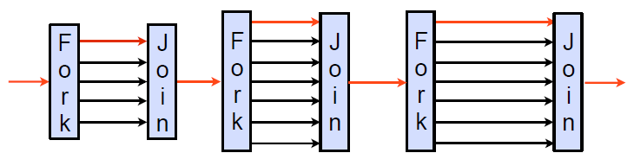
Fork-Join Parallelism
OpenMP program begin as a single process: the master thread. The master thread executes sequentially until the first parallel region construct is encountered.
When a parallel region is encountered, master thread
Create a group of threads by FORK.
Becomes the master of this group of threads, and is assigned the thread id 0
within the group.
The statement in the program that are enclosed by the parallel region
construct are then executed in parallel among these threads.
JOIN: When the threads complete executing the statement in the parallel region construct, they synchronize and terminate, leaving only the master thread.
Master thread is shown in red.

Slide 22
Our first OpenMP Example
#include <stdlib.h>
#include <stdio.h>
#include "omp.h"
int main()
{
#pragma omp parallel
{
int ID = omp_get_thread_num(); printf("Hello (%d)\n", ID);
printf(" world (%d)\n", ID);
}
}
Set # of threads for OpenMP
In csh
setenv OMP_NUM_THREAD 8
Compile: g++ -fopenmp hello.c
Run: ./a.out

Slide 23






Thread Creation: Parallel Regions
You create threads in OpenMP* with the parallel construct.
For example, To create a 4 thread Parallel region:
double A[1000]; omp_set_num_threads(4);
#pragma omp parallel
Runtime function to
Each thread executes a copy of the
code within the structured block
request a certain
number of threads
{
int ID = omp_get_thread_num();
pooh(ID,A);
}
Runtime function
returning a thread ID
l Each thread calls pooh(ID,A) for ID = 0 to 3

Slide 24




Thread Creation: Parallel Regions
double A[1000];
#pragma omp parallel num_threads(4)
{
int ID = omp_get_thread_num(); pooh(ID, A);
}
printf(“all done\n”);
Each thread executes the same code redundantly.
double A[1000];
omp_set_num_threads(4)
A single copy of A is shared between all threads.
pooh(0,A)
pooh(1,A)
pooh(2,A)
pooh(3,A)
printf(“all done\n”);
Threads wait here for all threads to finish before proceeding (i.e. a barrier)

Slide 25
OpenMP: what the compiler does
#pragma omp parallel num_threads(4)
{
foobar ();
}
void thunk ()
{
foobar ();
}
pthread_t tid[4];
for (int i = 1; i < 4; ++i) pthread_create (
&tid[i],0,thunk, 0); thunk();
for (int i = 1; i < 4; ++i) pthread_join (tid[i]);
The OpenMP compiler generates code logically analogous to that on the right of this slide, given an OpenMP pragma such as that on the top-left
All known OpenMP implementations
use a thread pool so full cost of threads creation and destruction is not incurred for reach parallel region.
Only three threads are created because the last parallel section will be invoked from the parent thread.

Slide 26
Programming Model – Concurrent Loops
OpenMP easily parallelizes loops
Requires: No data dependencies (reads/write or write/write pairs) between iterations!
Preprocessor calculates loop bounds for each thread directly from serial source
?
#pragma omp parallel for
for( i=0; i < 25; i++ ) {
printf(“Foo”);
}

Slide 27
OpenMP* Pragma Syntax
Most constructs in OpenMP* are compiler directives pragmas.
For C and C++, the pragmas take the form:
#pragma omp construct [clause [clause]…]
where clause is one of the following:
if([parallel :] scalar-expression)
num_threads(integer-expression)
default(shared | none)
private(list)
firstprivate(list)
shared(list)
copyin(list)
reduction(reduction-identifier : list)
proc_bind(master | close | spread)
Notes:
OpenMP* Pragma Syntax
For Fortran, you can also use other sentinel’s (!$OMP), but these must exactly line up on columns 1-5. Column 6 must be blank or contain a + indicating that this line is a continuation from the previous line.
C$OMP
*$OMP
!$OMP

Slide 28
OpenMP Constructs
OpenMP’s constructs:
Parallel Regions
Worksharing (for/DO, sections, …)
Data Environment (shared, private, …)
Synchronization (barrier, flush, …)
Runtime functions/environment variables (omp_get_num_threads(), …)

Slide 29
OpenMP Constructs
OpenMP language “extensions”
parallel control structures
parallel control
work sharing
data
environment
synchronization
runtime environment
governs flow of control in the program
distributes work among threads
specifies variables as shared or private
coordinates thread execution
•runtime functions
•environment variables
omp_set_num_threads() omp_get_thread_num() OMP_NUM_THREADS OMP_SCHEDULE
•scheduling
static, dynamic, guided
do
for sections directives
critical atomic barrier directive
shared private clauses
parallel directive

Slide 30
OpenMP: Structured blocks (C/C++)
Most OpenMP constructs apply to structured blocks.
Structured block: a block with one point of entry at the top and one point of exit at the bottom.
The only “branches” allowed are STOP statements in Fortran and exit() in C/C++.
#pragma omp parallel
{
more: do_big_job(id);
if(++count>1) goto more;
}
printf(“ All done \n”);
if(count==1) goto more;
#pragma omp parallel
{
more: do_big_job(id);
if(++count>1) goto done;
}
done: if(!really_done()) goto more;
A structured block
Not A structured block

Slide 31
Structured Block Boundaries
In C/C++: a block is a single statement or a group of statements between brackets {}
#pragma omp parallel
{
id = omp_thread_num();
A[id] = big_compute(id);
}
#pragma omp for
for (I=0;I<N;I++) {
res[I] = big_calc(I);
A[I] = B[I] + res[I];
}
In Fortran: a block is a single statement or a group of statements between directive/end-directive pairs.
C$OMP PARALLEL
10 W(id) = garbage(id)
res(id) = W(id)**2
if(res(id) goto 10
C$OMP END PARALLEL
C$OMP PARALLEL DO
do I=1,N res(I)=bigComp(I)
end do
C$OMP END PARALLEL DO

Slide 32
Parallel Programming in OpenMP: parallel construct

Slide 33
Parallel Regions
Defines parallel region over structured block of code
Threads are created as ‘parallel’ pragma is crossed threads block at end of region
Data is shared among threads unless specified otherwise
#pragma omp parallel
Thread
Thread
Thread
1
2
3
C/C++ :
#pragma omp parallel
{
block
}
Notes:
Parallel Regions
Other Fortran Methods.

Slide 34
Parallel Regions
1 | #pragma |  | omp | parallel
2 | {
3 |  | code block
4 |  | work(…);
5 | }
Line 1
Lines 3-4
Line 5
Team of threads formed at parallel region
Each thread executes code block and subroutine calls. No branching (in or out) in a parallel region
All threads synchronize at end of parallel region (implied barrier)
Use the thread number to divide work among threads

Slide 35
parallel construct
The syntax of the parallel construct
When a thread encounters a parallel construct, a team of threads is created to execute the parallel region.
#pragma omp parallel [clause[ [,] clause] ... ] new-line
structured-block
where clause is one of the following:
if([parallel :] scalar-expression)
num_threads(integer-expression)
default(shared | none)
private(list)
firstprivate(list)
shared(list)
copyin(list)
reduction(reduction-identifier : list)
proc_bind(master | close | spread)

Slide 36
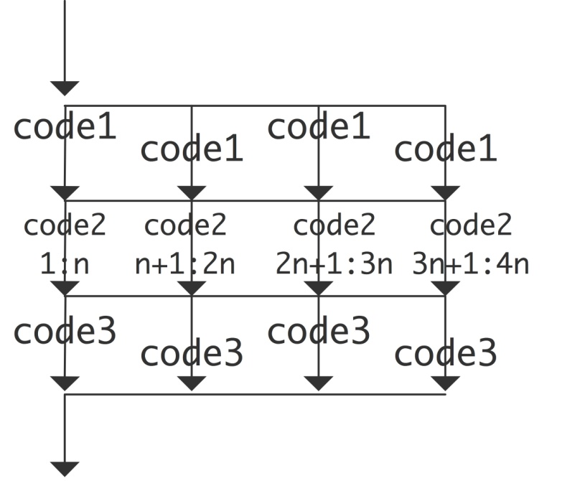
parallel construct example:
create a parallel region around the loop, and adjust the loop bounds:
Every thread has a thread Id to indentify itself
Threads execute same code statements
#pragma omp parallel {
int threadnum = omp_get_thread_num();
int numthreads = omp_get_num_threads();
int low = N*threadnum/numthreads;
int high = N*(threadnum+1)/numthreads;
for (i=low; i<high; i++) //
{ do something with i }
}

Slide 37
Example: sum of n²
#include<omp . h>
#include <stdio . h>
. . .
Int sum;
#pragma omp parallel
{
int myid , numthreads ,mysum, first , next , i ;
myid = omp_get_thread_num ( ) ;
numthreads=omp_get_num threads ( ) ;
mysum=0;
first=myid*N/ numthreads+1;
ne x t=(myid+1)N/ numthreads+1;
f o r ( i=first ; i<next ; i++)
mysum+=i*i ;
sum += mysum; //?????
}
Sum squares of numbers from 1to N
Smart way:
sum = n(n + 1)(2n + 1)/6
Dumb way:
Split the range 1..N across threads
Have each thread sum its squares Sum the results

Slide 38
How Many Threads?
The number of threads in a parallel region is determined by the following factors, in order of precedence:
Evaluation of the IF clause
Setting of the NUM_THREADS clause
Use of the omp_set_num_threads() library function
Setting of the OMP_NUM_THREADS environment variable
Implementation default - usually the number of CPUs on a node, though it could be dynamic (see next bullet).
Threads are numbered from 0 (master thread) to N-1

Slide 39
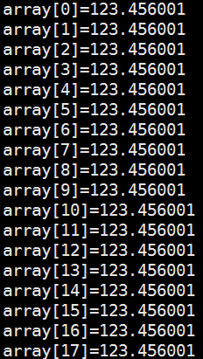
Example parallel
#include <omp.h>
void subdomain(float *x, int istart, int ipoints)
{
int i;
for (i = 0; i < ipoints; i++)
x[istart+i] = 123.456;
}
void sub(float *x, int npoints){
int iam, nt, ipoints, istart;
#pragma omp parallel default(shared)private(iam,nt,ipoints,istart)
{
iam = omp_get_thread_num();
nt = omp_get_num_threads();
ipoints = npoints / nt; /* size of partition */
istart = iam * ipoints; /* starting array index */
if (iam == nt-1) /* last thread may do more */
ipoints = npoints - istart;
subdomain(x, istart, ipoints);
}
}
int main(){
float array[10000];
sub(array, 10000); return 0;
}
Notes:
IF clause: If present, it must evaluate to .TRUE. (Fortran) or non-zero (C/C++) in order for a team of threads to be created. Otherwise, the region is executed serially by the master thread.

Slide 40
Parallel Programming in OpenMP: Data Environment

Slide 41
Data Environment
private
private
OpenMP uses a shared-memory programming model
But, not everything is shared...
Stack variables in functions called from parallel regions are PRIVATE
Automatic variables within a statement block are PRIVATE
Loop index variables are private (with exceptions)
C/C+: The first loop index variable in nested loops following a #pragma omp for
thread2
thread1
Shared
Memory
thread3
thread5
thread4
private
private
private
Notes:
Fortran will make all nested loop indices private.

Slide 42
Data Environment:Default storage attributes
Shared Memory programming model:
Most variables are shared by default
Global variables are SHARED among threads
Fortran: COMMON blocks, SAVE variables, MODULE variables
C: File scope variables, static
But not everything is shared...
Stack variables in sub-programs called from parallel regions are PRIVATE
Automatic variables within a statement block are PRIVATE.

Slide 43
Data sharing: Examples
double A[10]; int main() { int index[10];
#pragma omp parallel work(index);
printf(“%d\n”, index[0]);
}
extern double A[10]; void work(int *index) { double temp[10]; static int count;
...
}
A, index,
count
A, index and count are shared by all threads.
temp is local to each thread
A, index and count are shared by all threads.
temp is local to each thread
temp
temp
temp
A, index,
count

Slide 44
Data Environment constructs
The OpenMP Data Scope Attribute Clauses are used to explicitly define how variables should be scoped. They include:
PRIVATE
FIRSTPRIVATE
LASTPRIVATE
SHARED
DEFAULT
REDUCTION
COPYIN
All the clauses on this page apply to the OpenMP construct NOT to the entire region.

Slide 45
Data Scope Attributes
The default status can be modified with
default (shared | none)
Scoping attribute clauses
shared(varname,…)
private(varname,…)
The shared clause declares one or more list items to be shared by tasks generated by a parallel, teams, or task generating construct.
Notes:
Data Scope Attributes
All data clauses apply to parallel regions and worksharing constructs except “shared,” which only applies to parallel regions.

Slide 46
The Private Clause
Reproduces the variable for each thread
Variables are un-initialized; C++ object is default constructed
Any value external to the parallel region is undefined
void* work(float* c, int N) {
float x, y; int i;
#pragma omp parallel for private(x,y)
for(i=0; i<N; i++) {
x = a[i]; y = b[i];
c[i] = x + y;
}
}
Notes:
Private Cause
For-loop iteration variable is PRIVATE by default.

Slide 47
The Private Clause:example
The private clause declares one or more list items to be private
#include <omp.h>
#include <stdio.h>
main()
{
int k = 100;
#pragma omp parallel for private(k)
for ( k=0; k < 10; k++)
{
printf("k=%d\n", k);
}
printf("last k=%d\n",k);
}
result：
k=6
k=7
k=8
k=9
k=0
k=1
k=2
k=3
k=4
k=5
last k=100

Slide 48
Firstprivate Clause
Variables initialized from shared variable
incr=0;
#pragma omp parallel for firstprivate(incr)
for (I=0;I<=MAX;I++) {
if ((I%2)==0) incr++;
A(I)=incr;
}

Slide 49
int k = 100;
#pragma omp parallel for firstprivate(k)
for (int i=0; i < 4; i++)
{
k+=i;
printf("k=%d\n",k);
}
printf(“last k=%d\n", k);
result：
k=100
k=101
k=103
k=102
last k=100

Slide 50
lastprivate clause
The lastprivate clause declares one or more list items to be private, and causes the corresponding original list item to be updated after the end of the region.
int k = 100;
#pragma omp parallel for firstprivate(k),lastprivate(k)
for (int i=0; i < 4; i++)
{
k+=i;
printf("k=%d\n",k);
}
printf(“last k=%d\n”, k);
result：
k=100
k=101
k=103
k=102
last k=103

Slide 51
Data Sharing:A data environment test
Consider this example of PRIVATE and FIRSTPRIVATE
variables: A = 1,B = 1, C = 1
#pragma omp parallel private(B) firstprivate(C)
Are A,B,C local to each thread or shared inside the parallel region?
What are their initial values inside and values after the parallel region?
Inside this parallel region …
“A” is shared by all threads;; equals 1
“B” and “C” are local to each thread.
B’s initial value is undefined
C’s initial value equals 1
Following the parallel region ...
B and C revert to their original values of 1
A is either 1 or the value it was set to inside the parallel region

Slide 52
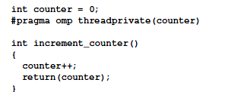
Threadprivate clause
The threadprivate directive specifies that variables are replicated with each thread having its own copy
Each copy of a threadprivate variable is initialized once, in the manner specified by the program
#pragma omp threadprivate(list)

Slide 53
copyin Clause
The copyin clause provides a mechanism to copy the value of the master thread’s threadprivate variable to the threadprivate variable of each other member of the team executing the parallel region.
copyin子句用于将主线程中threadprivate变量的值拷贝到执行并行区域的各个线程的threadprivate变量中，从而使得team内的子线程都拥有和主线程同样的初始值。
copyin(list)

Slide 54
counter = 10
count1 = 11, thread_num = 0
count1 = 12, thread_num = 0
count2 = 11, thread_num = 1
count2 = 12, thread_num = 1
count2 = 13, thread_num = 1
count2 = 14, thread_num = 1
counter = 12. I am thread 0
int main(int argc, char* argv[])
{
int iterator;
int counter = 10；
printf("counter = %d\n", counter);
#pragma omp parallel sections copyin(counter) private(iterator)
{
#pragma omp section
{
int count1;
for ( iterator = 0; iterator < 2; iterator++ )
{
count1 = increment_counter();
printf("count1 = %d, thread_num = %d\n", count1,omp_get_thread_num());
}
}
#pragma omp section
{
int count2;
for ( iterator = 0; iterator < 4; iterator++ )
{
count2 = increment_counter();
printf("count2 = %d, thread_num = %d\n", count2, omp_get_thread_num());
}
}
}
printf(“counter = %d， I am thread %d\n”, counter，omp_get_thread_num());
}
Notes:
通过Copyin操作，确实将线程的私有变量初始化为主线程中相应的全局变量的值。在并行区域执行完毕退出后，主线程与子线程中的相应的全局变量继续有效，并且在再一次进入并行区域时，使用上一次退出时所赋的值。

Slide 55
copyprivate Clause
The copyprivate clause provides a mechanism to use a private variable to broadcast a value from the data environment of one implicit task to the data environments of the other implicit tasks belonging to the parallel region.
copyprivate(list)
copyprivate子句用于将线程私有副本变量的值从一个线程广播到执行同一并行区域的其他线程的同一变量。

Slide 56
result：
ThreadId: 4, count = 51
ThreadId: 1, count = 51
ThreadId: 5, count = 51
ThreadId: 3, count = 51
ThreadId: 6, count = 51
ThreadId: 0, count = 51
ThreadId: 2, count = 51
ThreadId: 7, count = 51
int counter = 0;
#pragma omp threadprivate(counter)
int increment_counter(){
counter++;
return(counter);
}
main(){
#pragma omp parallel
{
int count;
#pragma omp single copyprivate(counter)
{ counter = 50; }
count = increment_counter();
printf("ThreadId: %ld, count = %ld\n", omp_get_thread_num(), count);
｝
}
Notes:
single编译制导语句指定内部代码只有线程组中的一个线程执行。
线程组中没有执行single语句的线程会一直等待代码块的结束，使用nowait子句除外
All list items that appear in the copyprivate clause must be either threadprivate or private in the enclosing context.

Slide 57
Example: Dot Product
float dot_prod(float* a, float* b, int N)
{
float sum = 0.0;
#pragma omp parallel for shared(sum)
for(int i=0; i<N; i++) {
sum += a[i] * b[i];
}
return sum;
}
What is Wrong?
Notes:
Multiple threads modifying sum with no protection

Slide 58
Protect Shared Data
Must protect access to shared, modifiable data
float dot_prod(float* a, float* b, int N)
{
float sum = 0.0;
#pragma omp parallel for shared(sum)
for(int i=0; i<N; i++) {
#pragma omp critical
sum += a[i] * b[i];
}
return sum;
}

Slide 59
OpenMP* Critical Construct
#pragma omp critical [(lock_name)]
Defines a critical region on a structured block
float RES;
#pragma omp parallel
{ float B;
#pragma omp for for(int i=0; i<niters; i++){
B = big_job(i);
#pragma omp critical (RES_lock) consum (B, RES);
} }
Threads wait their turn –at a time, only one calls consum() thereby protecting RES from race conditions
Naming the critical construct RES_lock is optional

Slide 60
OpenMP* Reduction Clause
reduction (op : list)
The variables in “list” must be shared in the enclosing parallel region
Inside parallel or work-sharing construct:
A PRIVATE copy of each list variable is created and initialized depending on the “op”
These copies are updated locally by threads
At end of construct, local copies are combined through “op” into a single value and combined with the value in the original SHARED variable

Slide 61
Reduction Example
#pragma omp parallel for reduction(+:sum)
for(i=0; i<N; i++) {
sum += a[i] * b[i];
}
Local copy of sum for each thread
All local copies of sum added together and stored in “global” variable

Slide 62
C/C++ Reduction Operations
A range of associative operands can be used with reduction
Initial values are the ones that make sense mathematically
Operand | Initial Value
+ | 0
* | 1
- | 0
^ | 0
Operand | Initial Value
& | ~0
| | 0
&& | 1
|| | 0

Slide 63
OpenMP data environment - summary
Variables are shared by default. Global variables are shared by default. Automatic variables within subroutines called from within a parallel region are private (reside on a stack private to each thread), unless scoped otherwise. Default scoping rule can be changed with default clause.
Data scope attribute clause description
private clause: declares the variables in the list to be private (not shared) to each thread.
firstprivate clause: declares variables in the list to be private plus the private variables are initialized to the value of the variable when the construct is encountered (”entered”).
lastprivate clause: declares variables in the list to be private plus the value of from the sequentially last iteration of the associated loops, or the lexically last section construct, is assigned to the original list item(s) after the end of the construct.
shared clause: declares the variables in the list to be shared among all the threads in a team. All threads within a team access the same storage area for shared variables. Synchronization is generally advised if variables are updated.
reduction clause: performs a reduction on the scalar variables that appear in the list, with a specified operator.
default clause: allows the user to affect the data-sharing attribute of the variables appeared in the parallel construct.

